Slide 1

Financial Reporting Automation Framework
Automating financial data from collection to visualization for real-time insights.

Slide 2


Project Overview & Objective
Project Overview
Core Objectives
The framework automates collecting, transforming, and reporting financial data. It consolidates data from sources like Kaggle Finance Data, uses a Python ETL, stores in BigQuery, and visualizes with Streamlit.
Automate end-to-end processing, build a scalable ETL, standardize key metrics (revenue, profitability), and deliver interactive dashboards to reduce manual effort and reporting delays.

Slide 3
Technical Specifications
Component | Technology Used
Data Sources | Kaggle Financial Datasets
Programming Language | Python
Data Processing | Pandas, PySpark
Data Warehouse | Google BigQuery
Reporting / Visualization | Streamlit
Version Control | GitHub

Slide 4






Design Solutions: Building Pipelines
Extract (E)
Transform (T)
Load (L)
Extract data from multiple financial APIs (Kaggle) and flat files (CSV/Excel).
Clean, normalize, and enrich data (handle nulls, compute ratios, categorize).
Load transformed data into BigQuery fact and dimension tables.

Slide 5
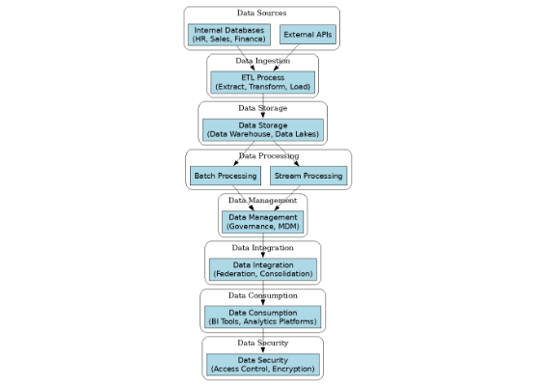
High-Level Design (HLD)
•
Source: APIs (Yahoo Finance, Kaggle).
•
Ingestion: Python scripts (requests, pandas).
•
Staging: Raw data in CSV/Parquet (S3/Local).
•
Transform: Data cleaning, standardization, derived KPIs.
•
Storage: BigQuery (Fact/Dimension models).
•
Reporting: Streamlit Dashboard.

Slide 6


Low-Level Design: Star Schema
Fact Table: Fact_Financials
Dimension Tables
Contains quantitative metrics like Revenue, Gross Profit, Net Income, EPS, ROE, ROA, and Debt/Equity. Linked via foreign keys.
Provide context: Dim_Company (Name), Dim_Category (Sector), Dim_Time (Year), Dim_Location (Region).

Slide 7

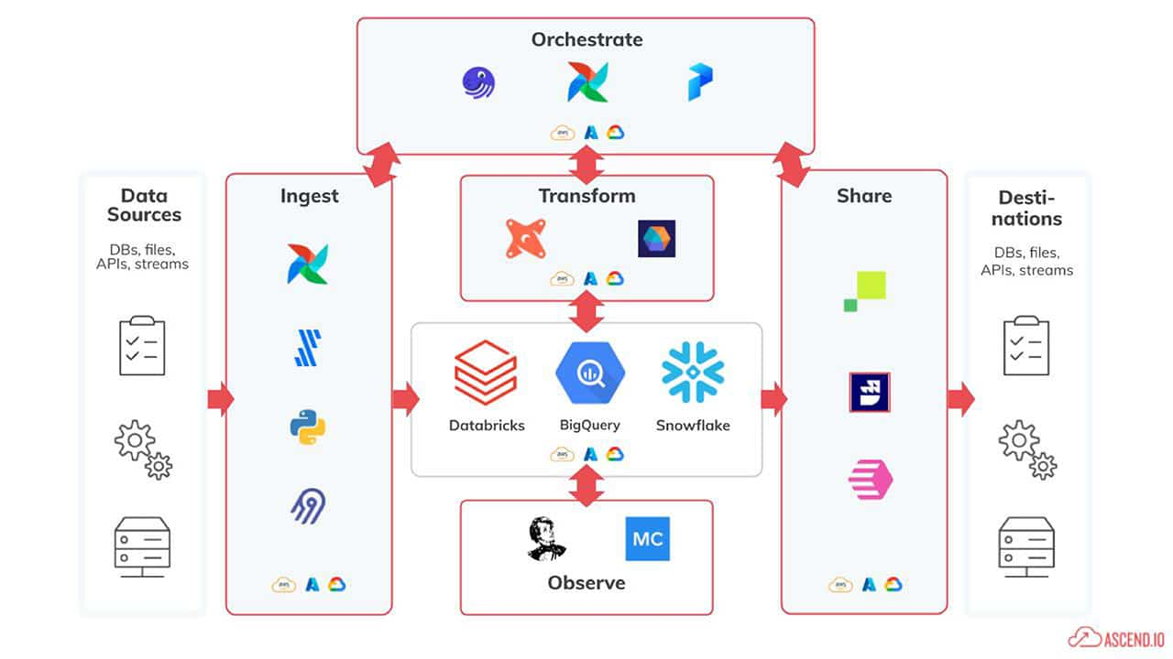
End-to-End Pipeline Flow
•
Real-time & Batch: Fetches live metrics of Finance and processes batch data (Kaggle) periodically.
•
Storage Strategy: Raw data is archived in S3/Cloud Storage for traceability. Processed, queryable data resides in BigQuery.
•
Automation: Entire workflow is scheduled using or Cloud Scheduler for hands-free operation.

Slide 8


Error Handling & Data Quality
Data Quality Rules
Error Handling
Null value handling, data type validation, duplicate checks (Company–Year), and range checks (e.g., ratios 0-100).
Try/Except blocks in Python, external logging, and Email/Slack alerts on ETL failure.

Slide 9
Pipeline Orchestration
2. Transform
4. Validate
Transform Data (Python).
Run Data Quality Checks.
1. Extract
3. Load
Extract Data from APIs.
Load Data into BigQuery.

Slide 10
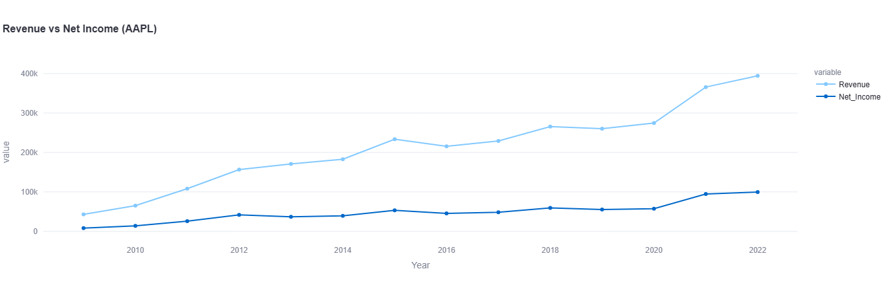
Visualizations (Streamlit Dashboard)
Revenue & Profitability Metrics

Slide 11
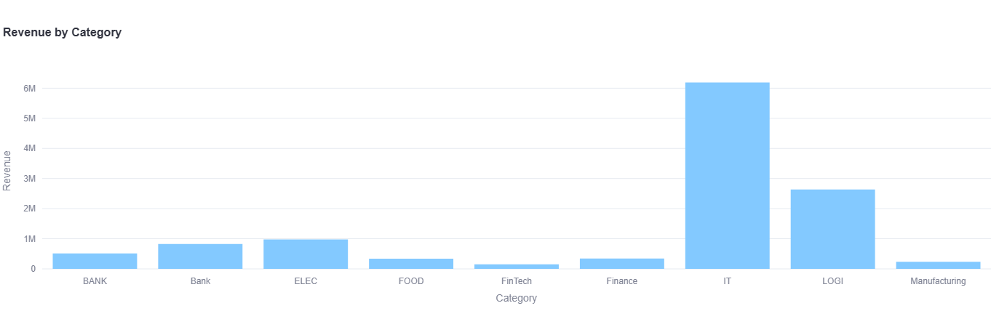
Revenue by Category (Aggregated)

Slide 12
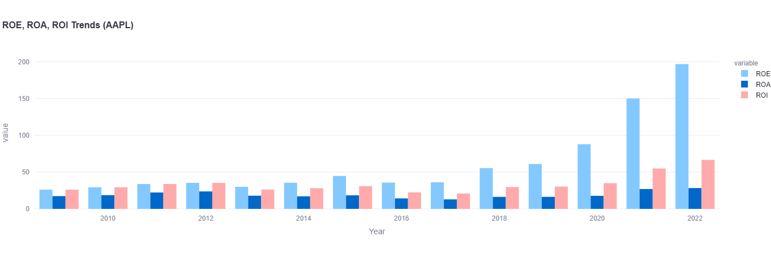
Return and Ratio Metrics

Slide 13
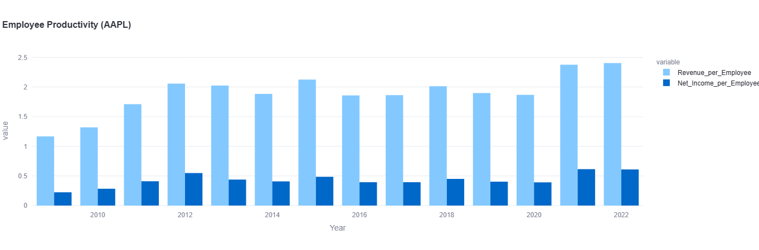
Efficiency & Productivity Metrics

Slide 14
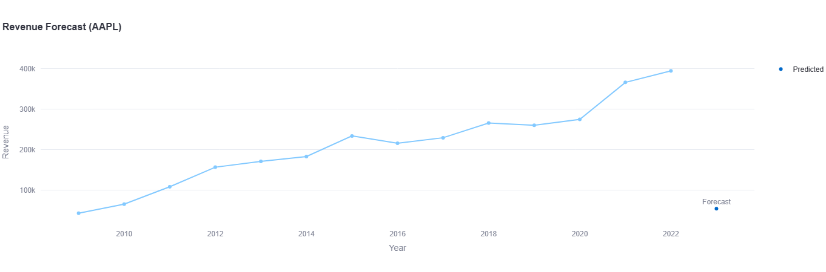
Predictive & Trend Analysis — Simple Forecast

Slide 15
Thank You

